Slide 1


Data Scraping & Analysis of Top Indian Colleges
Exploring fees, placements, rankings, and ROI with real-world data.
Presented by: Ashok T

Slide 2

Introduction
Education in India is vast, with thousands of colleges across Engineering, MBA, and Medical streams. Students face difficulty comparing them because information is scattered.
👉 Our project simplifies this by scraping, cleaning, and analyzing data from a reliable source.

Slide 3

Why Shiksha.com?
Largest Platform
Comprehensive Data
One of India’s largest platforms for college comparison.
Provides fees, placements, ratings, reviews, and NIRF ranks.
Student Trust
Widely used by students and parents while making decisions.
📌 That’s why we chose Shiksha as our trusted data source.

Slide 4
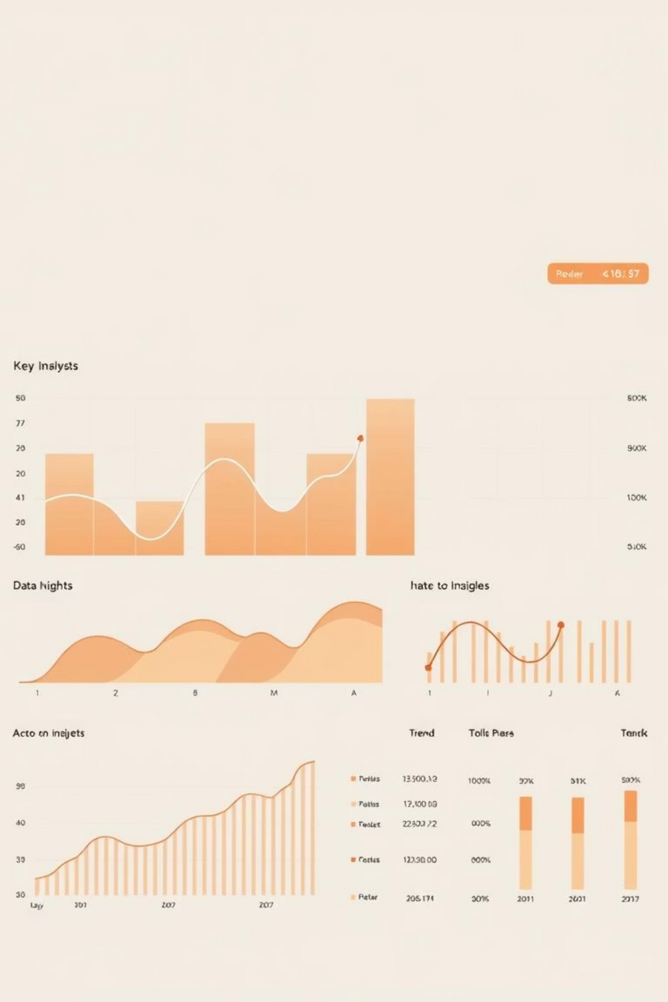
Project Objectives
1
2
Scrape Data
Clean Data
Collect details on top colleges.
Handle duplicates, missing values, and formats.
3
Analyze Data
Generate insights on ROI, fees, and placements.
✨ Final outcome: A clear picture of India’s higher education trends.

Slide 5
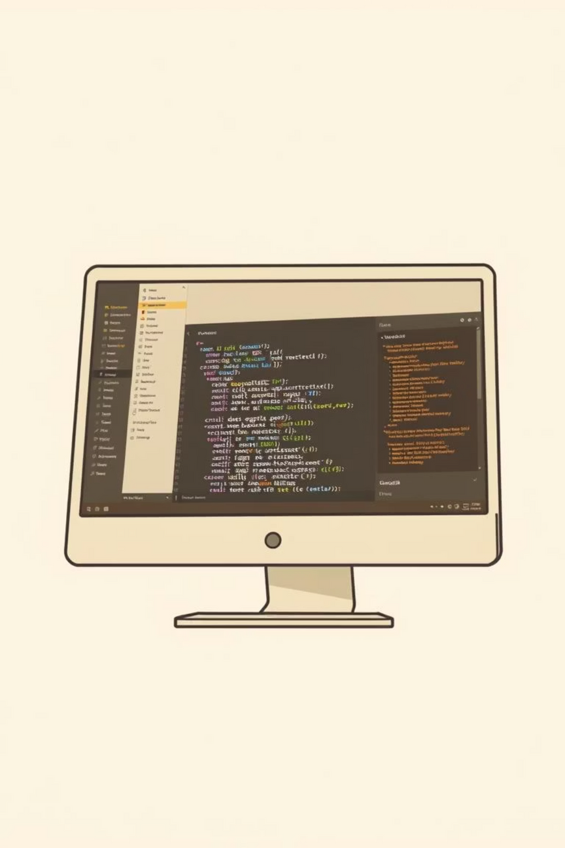


Technology Stack
We used a Python-based ecosystem:
Requests + BeautifulSoup
Web scraping.
Pandas + NumPy
Data processing & cleaning.
Matplotlib + Seaborn
Visualizations.
🔧 These tools helped us move from messy web pages to actionable insights.

Slide 6
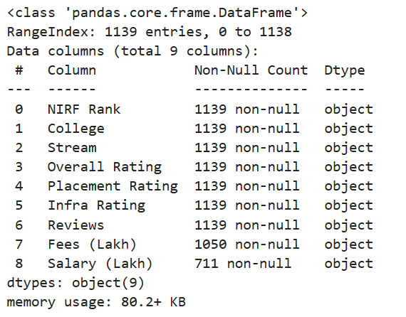
Data Collection
Total of 1139 records scraped across Engineering, MBA, and Medical.
Attributes: College Name, Stream, NIRF Rank, Fees, Salary, Reviews, Ratings.
Saved into a structured CSV dataset for processing.

Slide 7


Data Cleaning
We ensured the dataset was reliable:
Removed Duplicates
Numeric Conversion
Missing Value Imputation
Resulting in 419 unique colleges.
Converted fees, salaries, and ranks into numeric form.
Filled missing values using median imputation per stream.
✅ Result: A clean, consistent dataset for analysis.

Slide 8
📊 Analysis Section

Slide 9
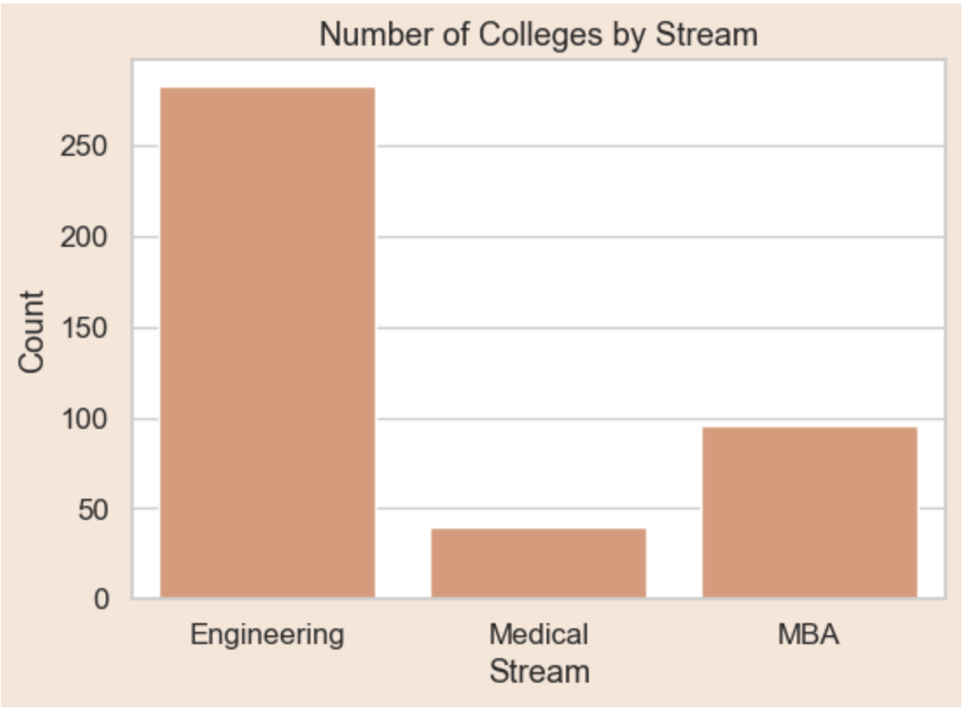
Section 1: Understanding the Landscape
Count of Colleges by Stream
Engineering dominates the landscape with 283 colleges, MBA has 96, Medical 40.
This indicates how Engineering is oversaturated compared to other streams.
📌 Students face higher competition in Engineering, while MBA/Medical are niche.

Slide 10
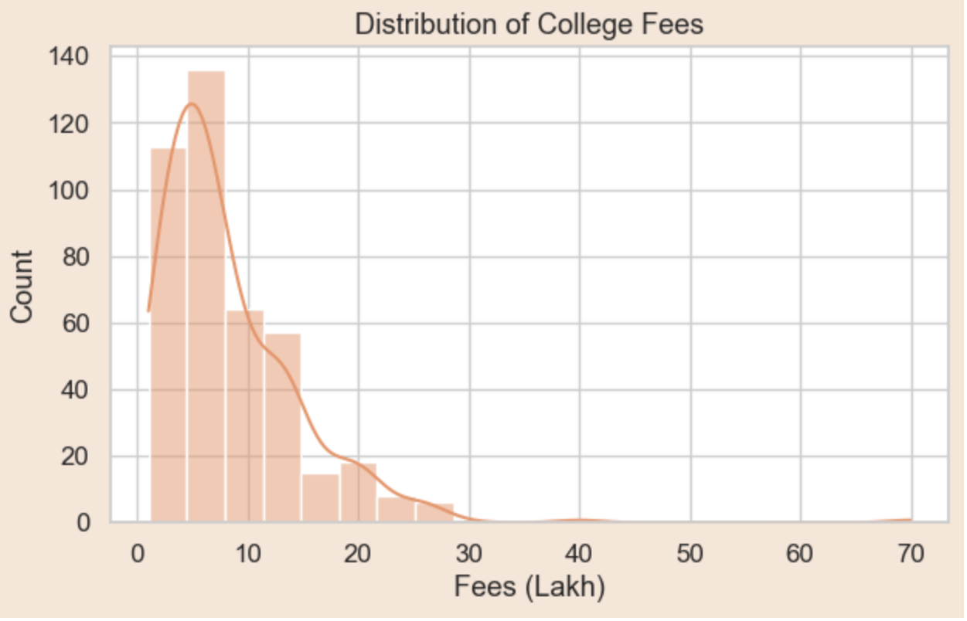
Distribution of Fees in Indian Higher Education
Most colleges fall between ₹5–15 lakh, with rare outliers above ₹20 lakh. This shows that higher education in India is still moderately priced, though MBA tends to cost more.

Slide 11
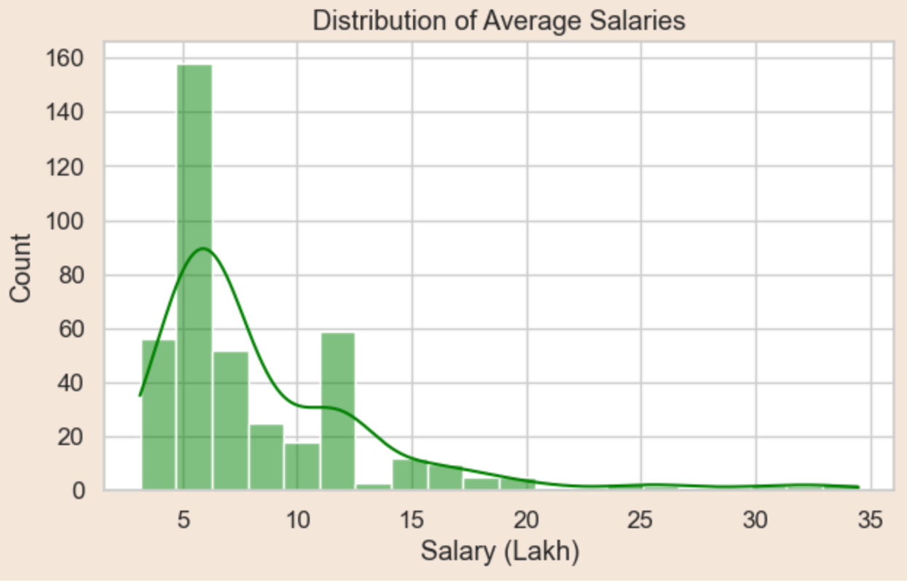
Salary Distribution Post-Graduation
Upon graduation, the salary landscape in India presents a varied picture:
The majority of salaries lie between ₹5–20 lakh.
Only a few top institutes manage to offer packages that cross ₹30 lakh.
Outcome: Top packages are rare; average salaries are modest, highlighting the competitive nature of the job market.

Slide 12
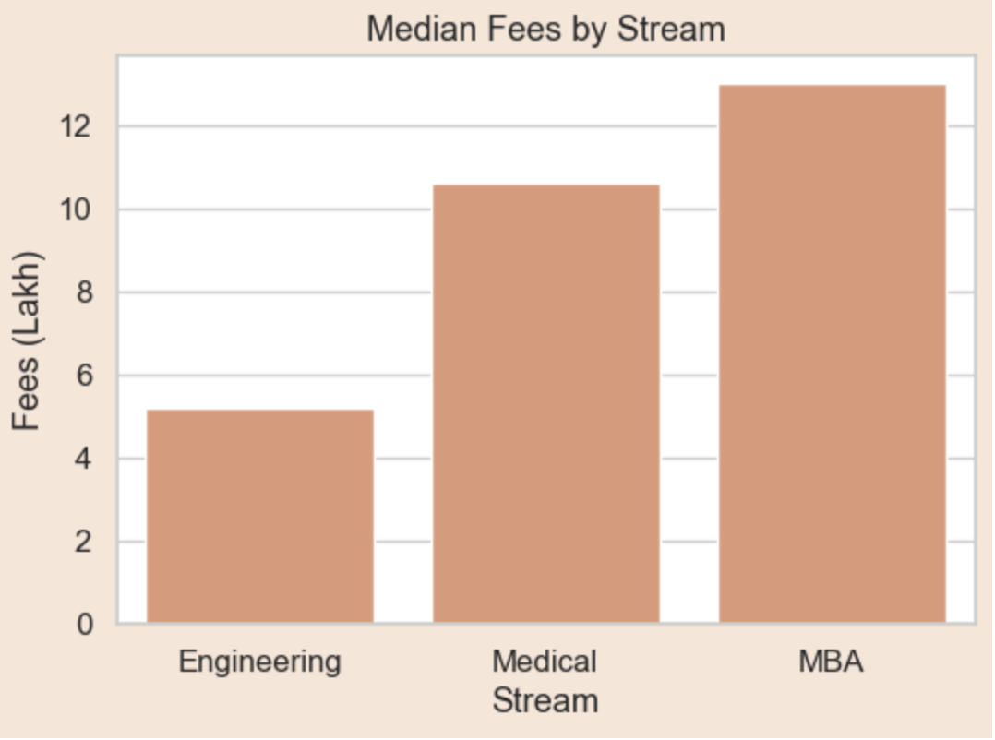
Section 2: Comparing Streams
Median Fees by Academic Stream
Understanding the financial commitment for different academic streams is crucial for prospective students:
MBA has the highest median fees, reflecting its premium positioning.
Engineering is the most affordable among the three, making it accessible to a wider demographic.
Medical sits in between, requiring a significant but manageable investment.
Insight: An MBA requires a big financial commitment upfront, demanding careful consideration of its potential returns.

Slide 13
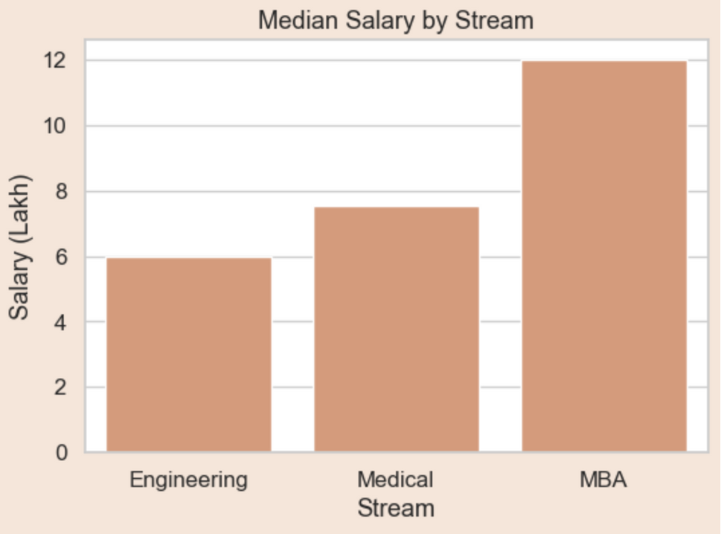

Median Salary by Academic Stream
The median salary varies significantly across different academic streams, influencing career expectations:
MBA salaries are the highest, but they also tend to vary widely, indicating a high-risk, high-reward scenario.
Students need to weigh “potential vs stability” carefully when choosing their academic path.
Medical offers stable outcomes, providing consistent and predictable career progression.
Engineering salaries are modest but predictable, offering a reliable entry into the professional world.

Slide 14
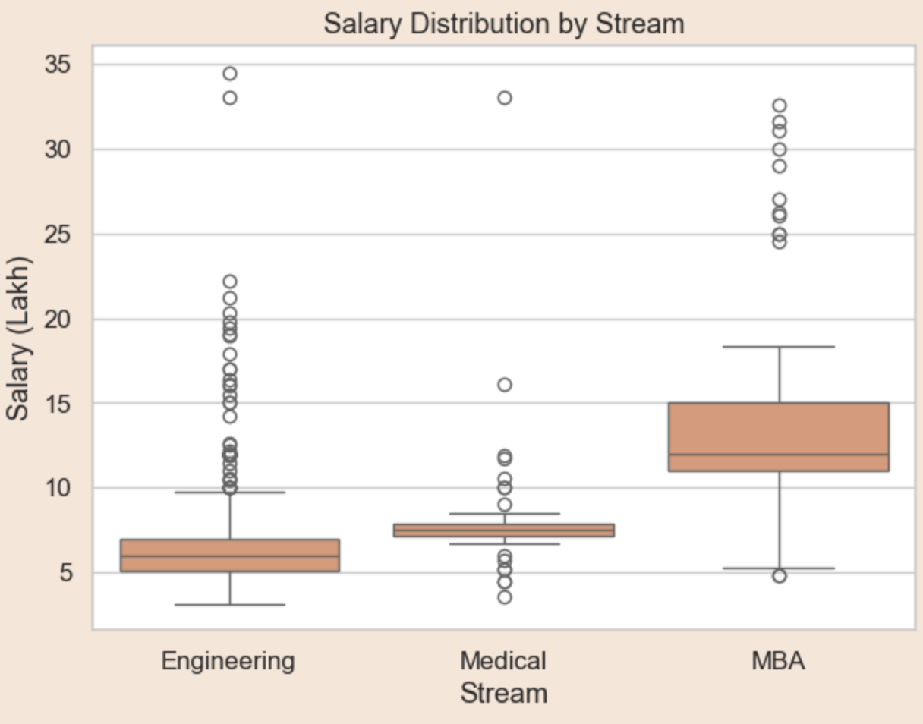
Salary Distribution Characteristics by Stream
MBA: High Potential, Inconsistency
A closer look at salary distributions reveals distinct patterns for each major academic stream:
MBA graduates often see the highest salary ceilings, but there's a significant spread, meaning not everyone achieves top-tier compensation. Success heavily depends on the institution, specialization, and individual performance.
Engineering: Stable, Fewer Extremes
Engineering salaries are generally more consistent. While there are fewer extreme high-end packages compared to MBA, the baseline is solid, and career progression is often steady and predictable.
Medical: Balanced and Consistent
The medical field typically offers a balanced salary distribution. Compensation tends to be stable and grows with experience and specialization, providing a reliable long-term career path with less volatility.

Slide 15
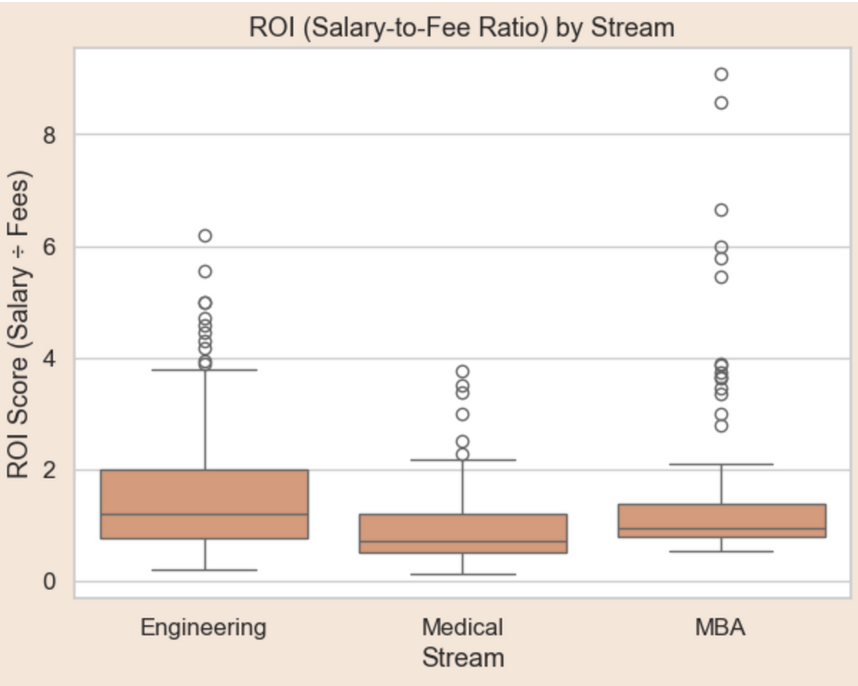
Return on Investment (ROI) by Stream
ROI, calculated as Salary ÷ Fees, is a critical metric for evaluating the financial wisdom of an educational investment.
Engineering
Highest ROI
Engineering consistently shows the highest ROI, meaning better returns for the money spent on education. Its relatively lower fees combined with predictable salaries make it a financially sound choice.
MBA
Riskier Investment
MBA is riskier: high fees coupled with uncertain salaries mean that while the potential for high returns exists, it's not guaranteed for everyone.
Understanding ROI helps students make informed decisions about their future.
This analysis underscores the importance of looking beyond just salary potential and considering the initial investment.

Slide 16
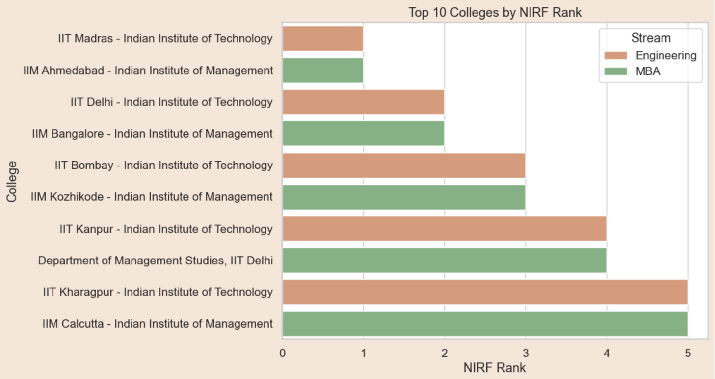
Section 3: Rankings & Outcomes
Top 10 Colleges by NIRF Rank
The National Institutional Ranking Framework (NIRF) provides a comprehensive ranking of higher education institutions in India.
IITs dominate Engineering rankings, recognized for their academic rigor and research output.
IIMs dominate MBA rankings, known for their strong industry connections and leadership development programs.
These rankings reflect strong academic reputation and consistent placement history, making them highly sought-after institutions.

Slide 17
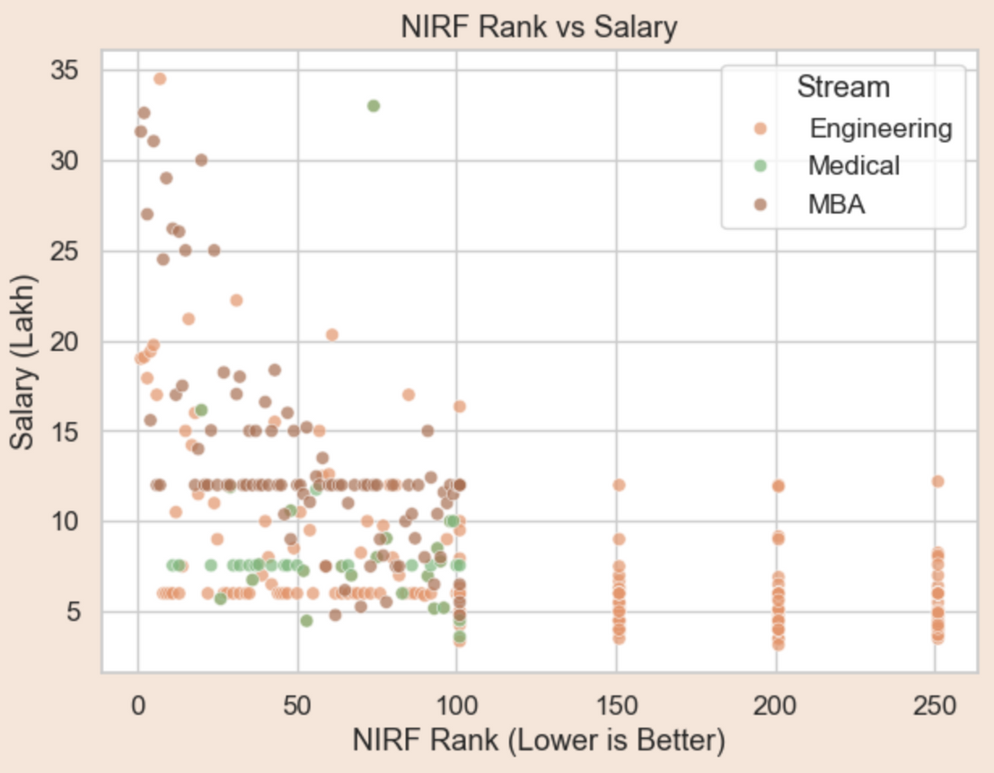
NIRF Rank vs. Salary Correlation
It is generally observed that a better NIRF rank correlates with a higher average salary for graduates. This is often due to factors like:
Stronger academic programs and faculty.
Better industry connections and recruitment opportunities.
A more competitive student body.
However, exceptions show that brand name is not the only factor determining salary outcomes. Placements matter too, emphasizing the importance of a college's career services and industry engagement.
While a general trend exists, individual outcomes can vary.

Slide 18
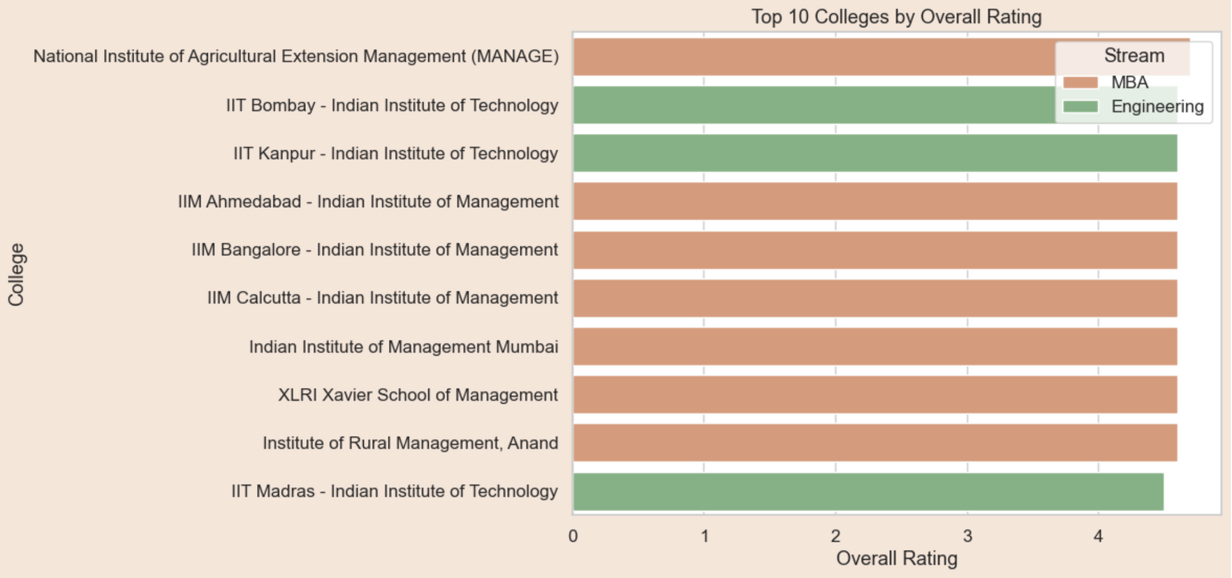
Top 10 Colleges by Student Rating
Beyond official rankings, student perception offers a unique and valuable perspective on college experiences.
This highlights the gap between official rankings and lived experiences. Student ratings often prioritize factors like teaching quality, campus environment, and student support, which might not be fully captured by traditional metrics.

Slide 19
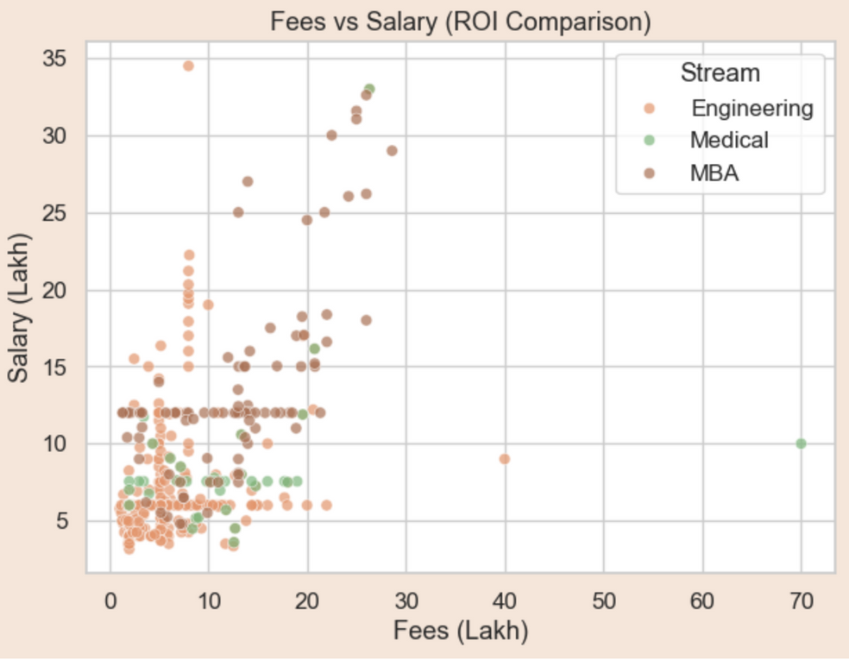
Section 4: ROI & Decision-Making Insights
Fees vs. Salary: Unveiling Hidden Gems
The relationship between college fees and post-graduation salaries is not always linear:
High fees do not always guarantee a high salary. Some expensive institutions may not deliver proportional returns.
Conversely, many affordable colleges outperform expensive ones in terms of graduate salaries, offering excellent value for money.
Insight: Hidden gems exist in every stream. These are institutions that provide strong academic programs and excellent placement opportunities without the burden of exorbitant fees. Researching beyond top-tier lists can uncover these valuable options.
Discovering value beyond the obvious choices.

Slide 20
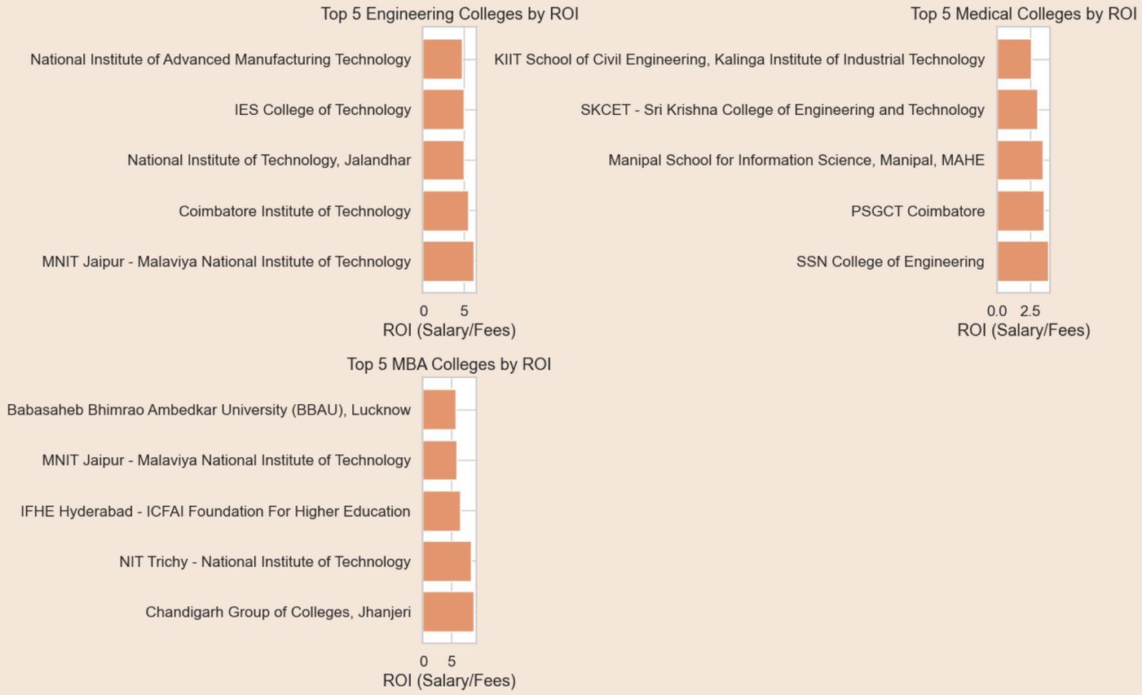
Top 5 ROI Colleges
These colleges provide the best salary-to-fee ratio.
They prove ROI matters more than just brand image.
Optimal Salary-to-Fee Ratio
These institutions stand out by offering an exceptional return on investment, ensuring graduates achieve high earning potential relative to their tuition costs.
Beyond Brand Image
Their success underscores that true value lies in tangible outcomes and financial benefits, rather than solely relying on a college's perceived prestige.

Slide 21
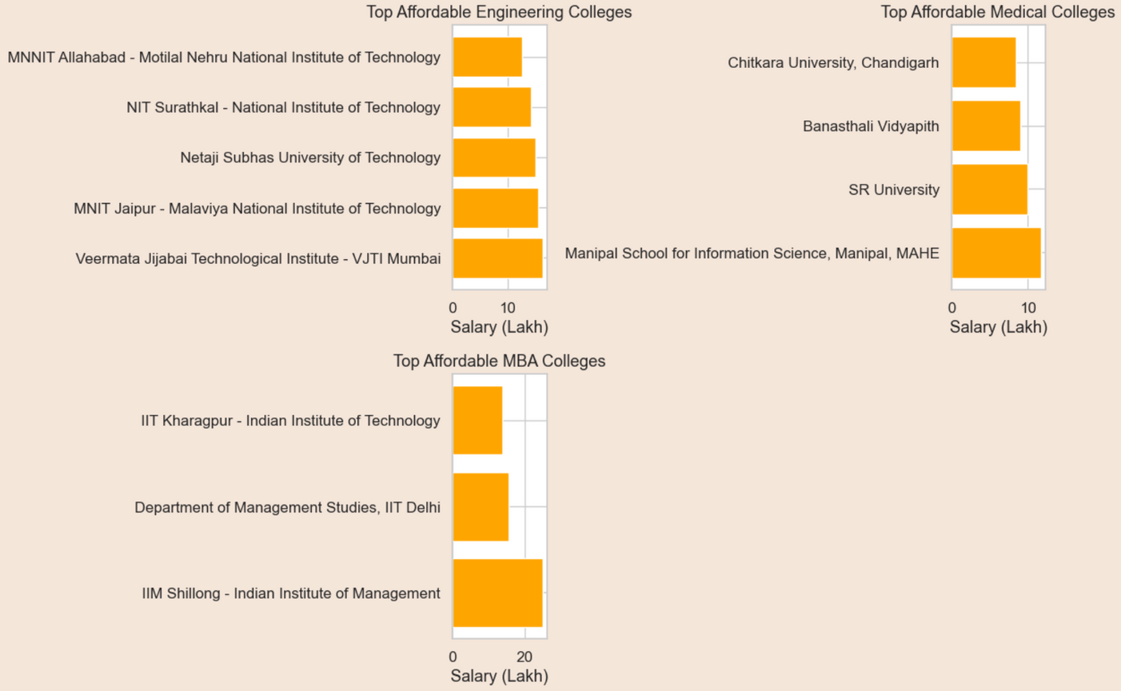
Top 5 Affordable Colleges
Low Fees, High Outcomes
These colleges combine accessible tuition rates with strong post-graduation salary prospects, making quality education attainable for more students.
Smart Choices for Families
They represent intelligent educational investments, particularly for middle-class families seeking excellent value without compromising on future career success.

Slide 22
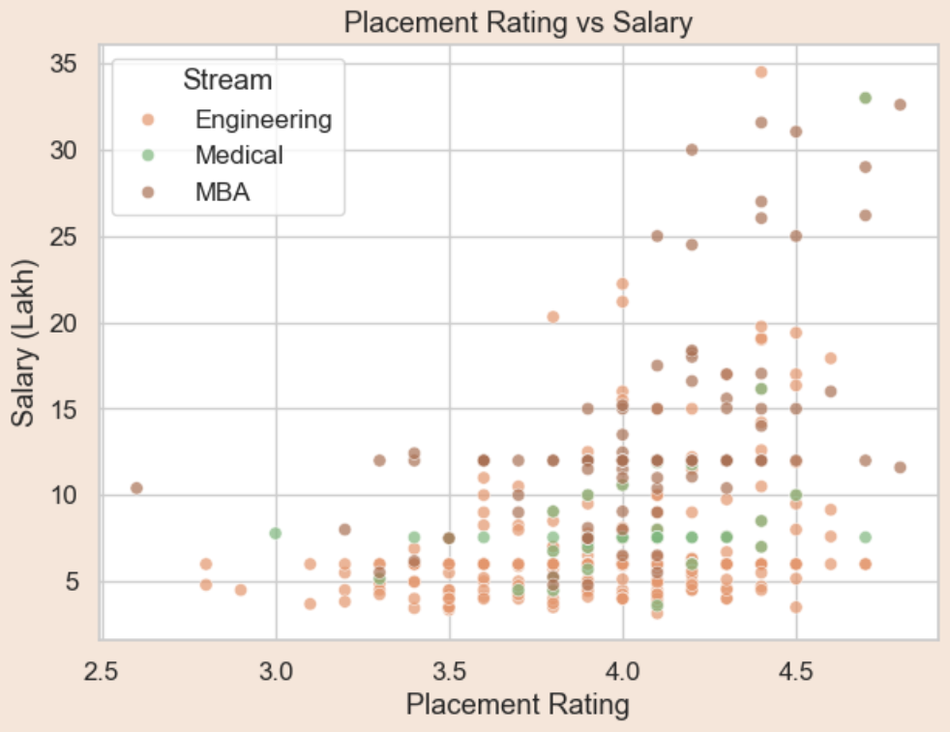

Placement Rating vs Salary
Higher placement ratings strongly correlate with higher salaries.
This validates the importance of placement cells in student success.
Direct Correlation
Our analysis reveals a clear and strong link: colleges with superior placement services consistently produce graduates who command higher salaries.
Crucial Role of Placement Cells
This finding emphasizes that robust career support and effective placement initiatives are fundamental drivers of student success and earning potential.

Slide 23
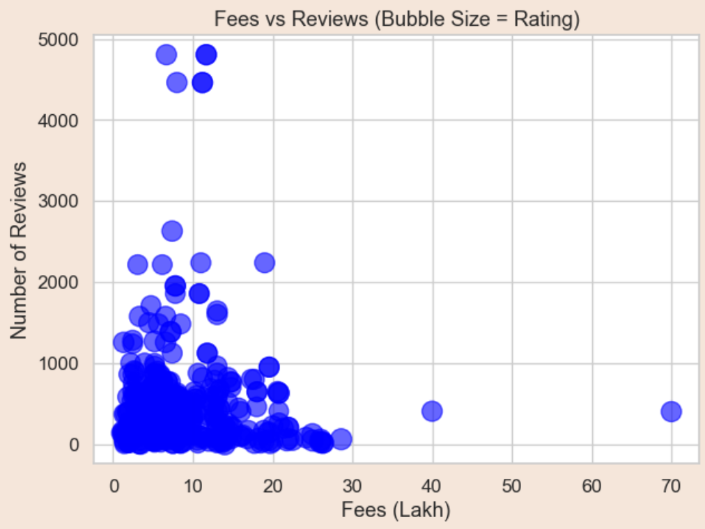

Fees vs Reviews
Reputation Through Reviews
Colleges that garner a higher volume of student reviews tend to possess a stronger and more established reputation within the academic community.
Fees Don't Drive Reviews
Interestingly, the cost of tuition does not appear to be a significant factor influencing the quantity or frequency of student reviews a college receives.

Slide 24

Insights & Closing

Slide 25




Key Insights
Engineering Landscape
MBA's High Stakes
While the engineering field is highly saturated, it consistently offers the best return on investment for graduates.
MBA programs are expensive, providing the potential for high salaries but also carrying a higher degree of financial risk.
Affordable Advantage
Surprisingly, colleges with lower tuition fees often demonstrate better performance metrics than their more expensive counterparts.
💡 Data empowers smarter student decisions.

Slide 26

Conclusion
This project shows how data scraping + analysis can turn scattered web info into actionable insights.
Our work demonstrates the data-driven decision-making in education.
🙏 Thank you for listening. Questions are welcome.

